Slide 1
Machine Learning
Assignment 1
Group 1
Jonas Kompauer, 11776872
Lukasz Sobocinski, 12123563
Florian Lackner, 11704916

Slide 2
Dataset - Diabetes
Small Dataset, ~770 rows
8 numeric features
Missing values
Index | Pregnancies | Glucose | Blood Presure | Skin Thickness | Insulin | BMI | Diabetes Pedigree Function | Age | Outcome
0 | 6 | 148 | 72 | 35 | 0 | 33.6 | 0.627 | 50 | 1
1 | 1 | 85 | 66 | 29 | 0 | 26.6 | 0.351 | 31 | 0
2 | 8 | 183 | 64 | 0 | 0 | 23.3 | 0.672 | 32 | 1
3 | 1 | 89 | 66 | 23 | 94 | 28.1 | 0.167 | 21 | 0

Slide 3
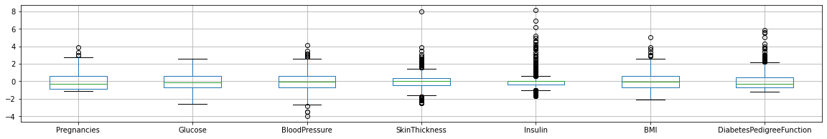
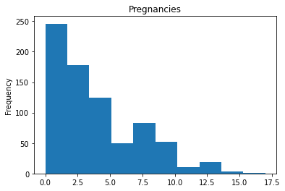
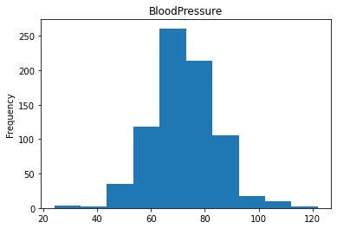
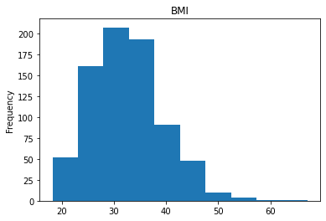
Dataset - Diabetes

Slide 4
Dataset - Breast Cancer
Small Dataset, ~280 rows
30 numeric features
No missing values
ID | class | radiusMean | textureMean | perimeter Mean | smoothnes Mean | compactnes Mean | ... | symmetry Worst | fractal Dimension Worst
913102 | false | 14.64 | 16.85 | 94.21 | 0.08641 | 0.06698 | ... | 0.2455 | 0.06596
89511501 | false | 12.2 | 15.21 | 78.01 | 0.08673 | 0.06545 | ... | 0.2661 | 0.07961
87163 | true | 13.43 | 19.63 | 85.84 | 0.09048 | 0.06288 | ... | 0.2884 | 0.07371
894047 | false | 8.597 | 18.6 | 54.09 | 0.1074 | 0.05847 | ... | 0.3142 | 0.08116

Slide 5
Dataset - Purchase
Large Dataset, 10k rows
600 binary attributes
Target attribute consists of 100 classes
No missing values
ID | 0 | 1 | 2 | 3 | 4 | 5 | ... | 599 | class
0 | 0 | 0 | 0 | 1 | 1 | 0 | ... | 0 | 86
1 | 0 | 0 | 0 | 1 | 1 | 0 | ... | 0 | 81
2 | 0 | 1 | 1 | 1 | 1 | 1 | ... | 0 | 3
3 | 0, | 1 | 0 | 1 | 1 | 1 | ... | 0 | 19

Slide 6
Dataset - Speeddating ❤️
Data about 2 Persons -> find out if they match
Large Dataset, ~8k rows
Mixture of numerical and nominal data
121 features
Missing Values
wave | gender | age | race | importance_ same_race | attractive | funny | ... | met | match
1 | female | 21 | Asian/Pacific Islander/Asian-American | 2 | 6 | 8 | ... | 0 | 0
2 | male | 24 | European/Caucasian-American | 1 | 3 | 7 | ... | 1 | 1
3 | female | 26 | 'Latino/Hispanic American' | 1 | 9 | 9 | ... | 0 | 0

Slide 7
Classifier
 | kNN | Gaussian Naive Bayes | Decision Tree
Parameters | k, distance function, weighting | smoothing | depth, sample split, split selection, criterion
Results | mostly good results | best results for Purchase Dataset | less accurate, but still mostly good results
Time | fast fitting, slow predicting | more or less fast in both fitting and predicting | slow fitting, fast predicting

Slide 8
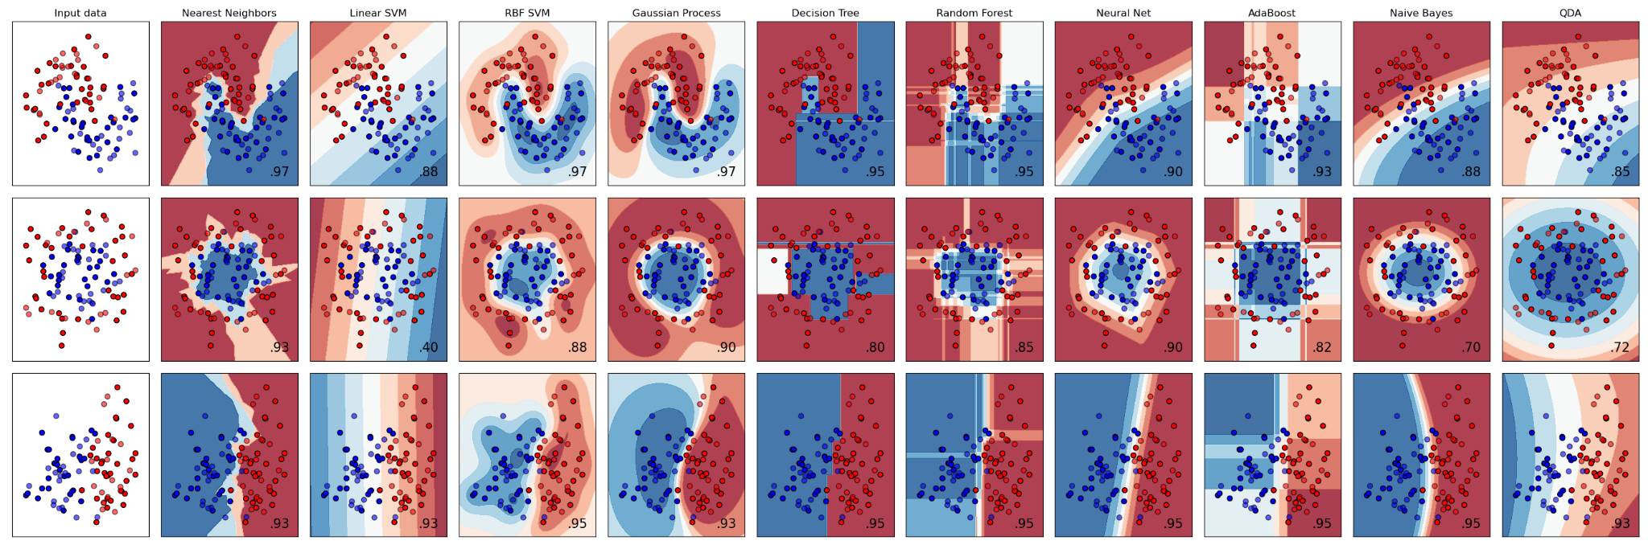
Usefulness kNN
Feature Scaling needed
Not Useful for large number of features
“Purchase” with 600 features no good results
“Speed Dating” with ~120 feature still good results
Otherwise very good results

Slide 9
Usefulness Gaussian Naive Bayes
Assumes independence of variables and their normal distribution
Not 100% given in our datasets
Still has the best results for “Purchase” Dataset
Accuracy of ~0.5
For other Datasets also good results
Diabetes with accuracy of 0.73
Speed Dating with accuracy of 0.859
Breast Cancer with accuracy of 0.947

Slide 10
Usefulness Decision Tree
Short classification time, when the model is trained
Too complex with large number of features/data
“Purchase” with 600 features bad results
“Speed Dating” with ~120 feature still good results, accuracy of ~0.86

Slide 11
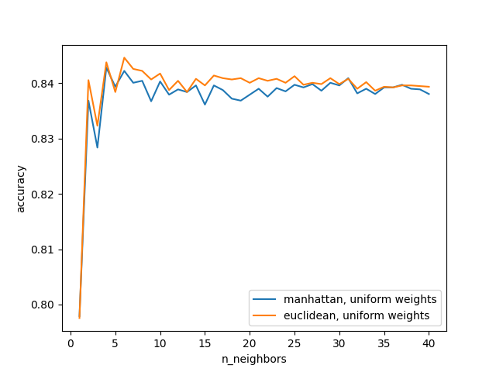
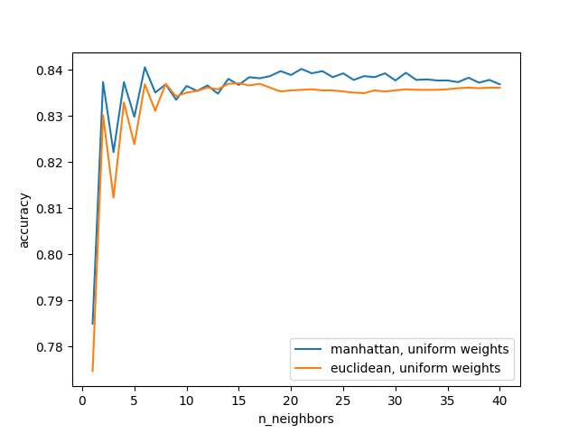
Findings
Scaling had close to no effect for kNN on accuracy
Scaling
No Scaling

Slide 12
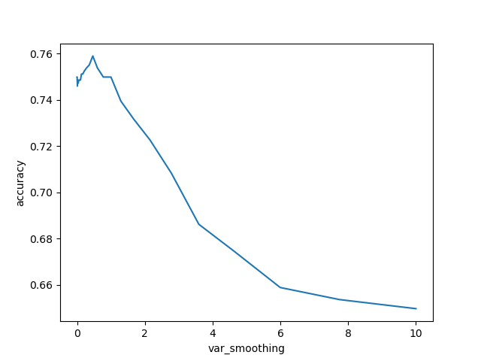
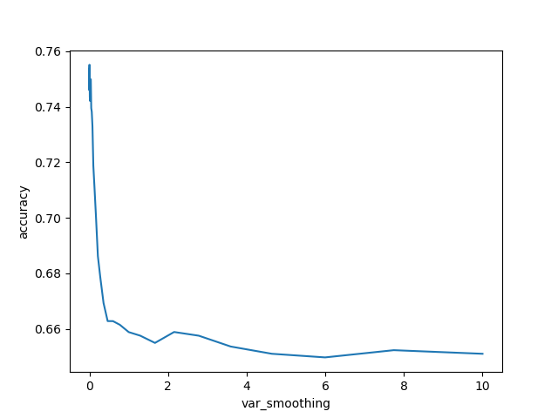
Findings
except...
Scaling
No Scaling

Slide 13
Issues
Hard to know on what to focus with experiments
Find important parameters to compare
4 datasets for 3 group members - difficult to split
Some classifiers were unstable - difficult to get the reliable performance measures

Slide 14
Summary
Decent results for the datasets
All Algorithms performed equally good on the datasets except for “Purchase”
CV is much more reliable than holdout for smaller datasets
There are no “universal” optimal tuning parameters, they depend on dataset and preprocessing

Slide 15
Thank you for
your attention!

